Slide 1
Task 1
Internship Studio’s Ethical Hacking Internship
Name : sejal singh E-mail: sejalsingh682@gmail.com Contact no.:8356866499

Slide 2
PortSwigger lab’s
snapshots in next few slides showing the completion of
task 1

Slide 3
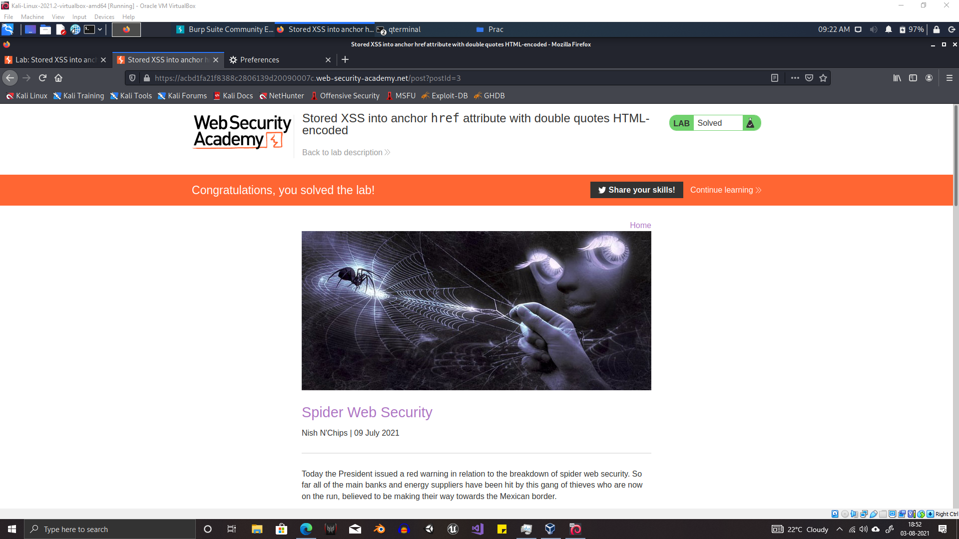

Slide 4
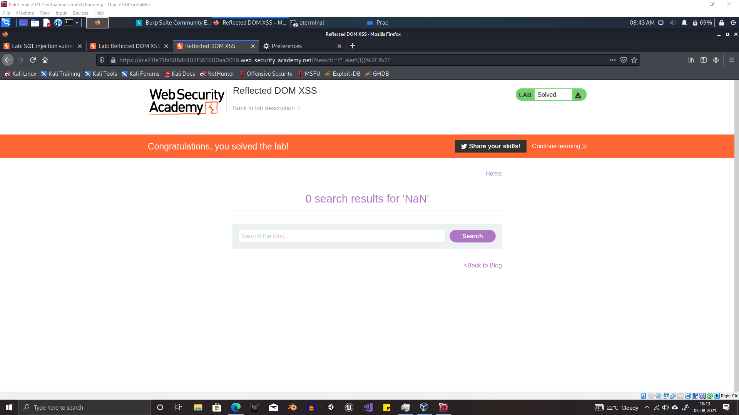

Slide 5
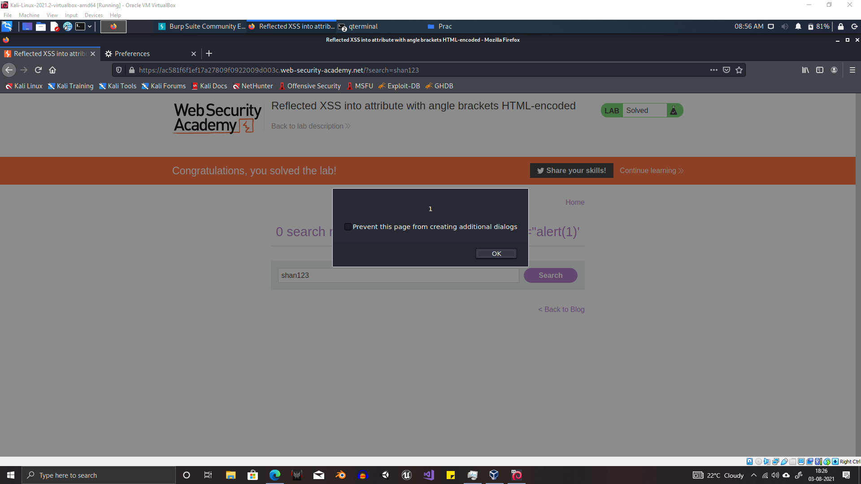

Slide 6
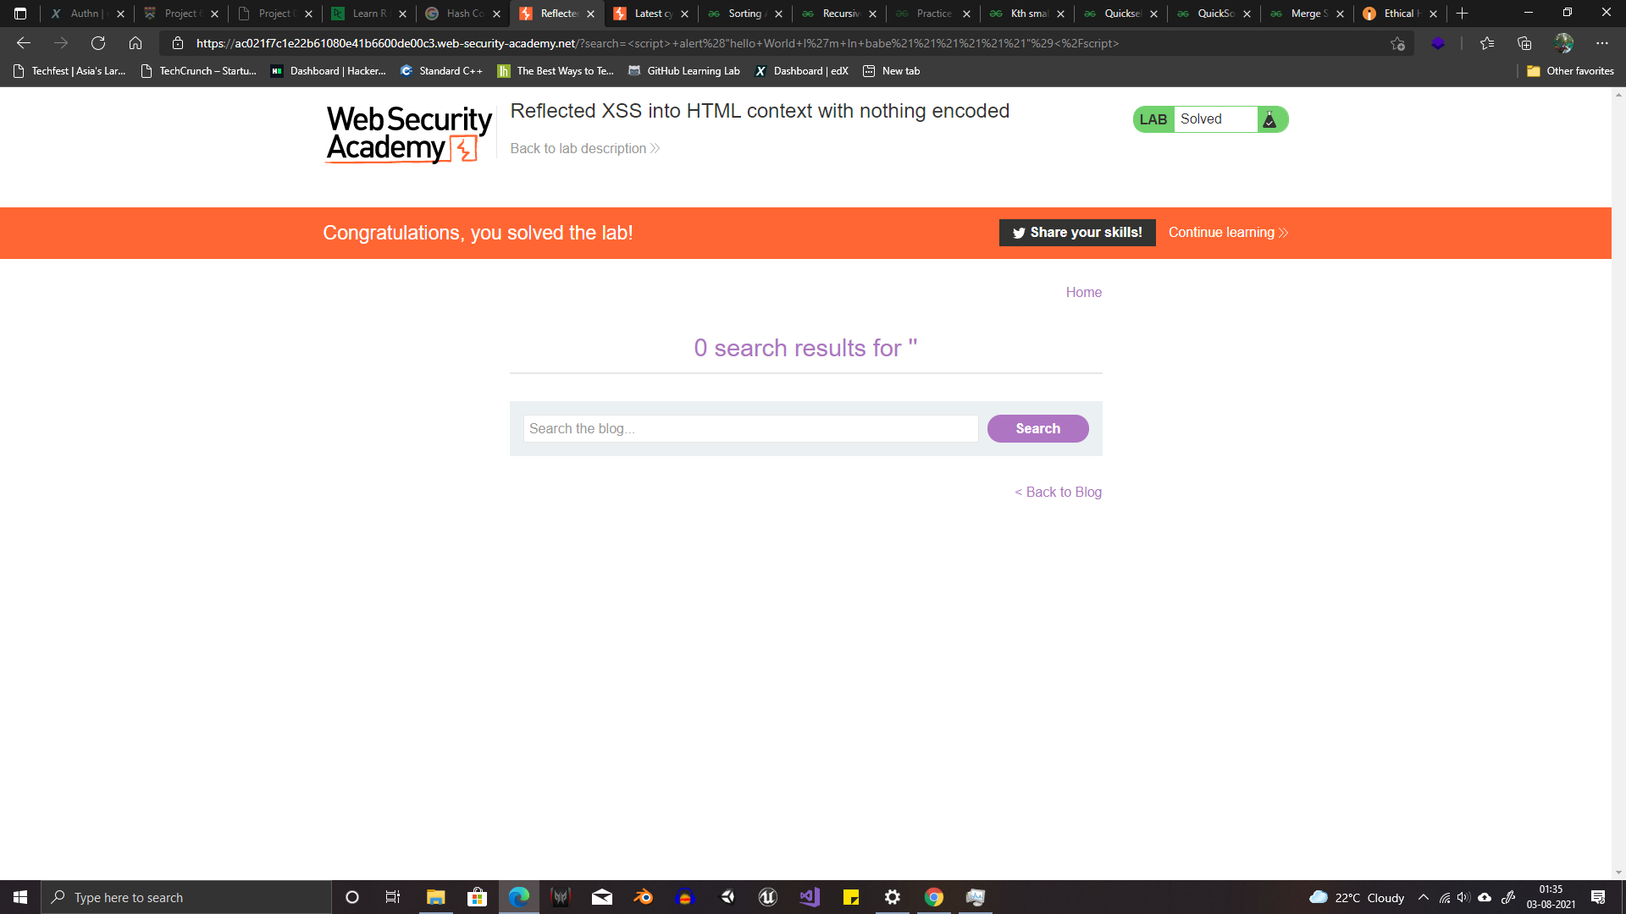

Slide 7
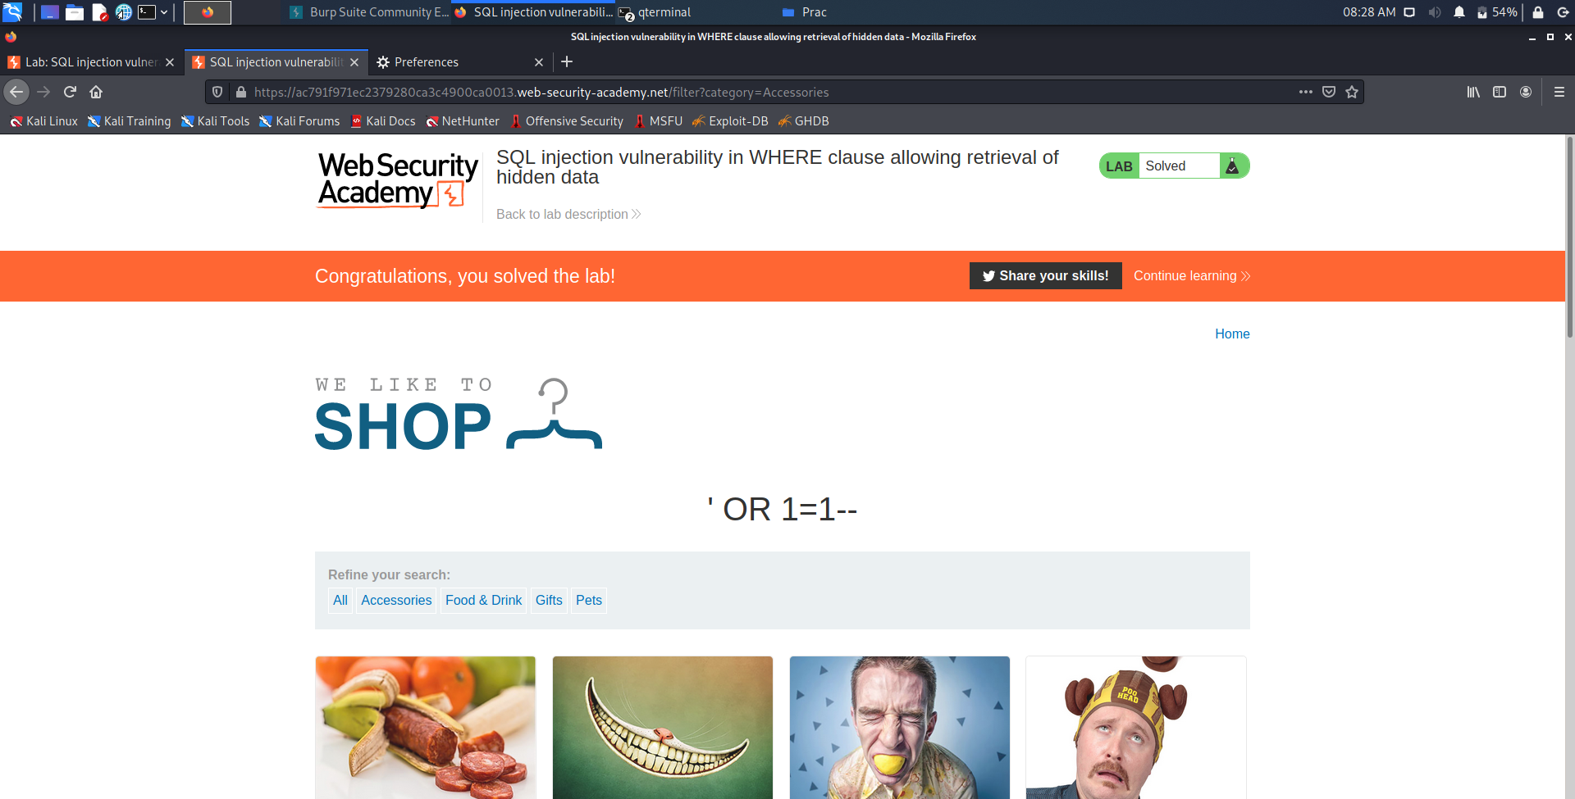

Slide 8
Thank You

